Slide 1
The First Asia-Pacific Summit of Social workers in Russia
Symposium < International models of social support of social workers and clients
: health, finance, risks at the welfare facilities >
An Introduction to Social Welfare Cooperative in Korea
For the better treatment of social welfare workers &
risk management of social welfare facilities
Oct. 2016.
Cho, Sung Chul
Chairman of The Board

Slide 2
Agenda
Korea Social Welfare Credit Union
I. Introduction
Background of foundation
Historic milestone
Focus on the legislation regarding 『the act on treatment and promotion of
status of social workers, etc.』
II. Korea Social Welfare Credit Union
Overview
Products & Services
III. Key challenges and Plan
IV. Conclusion

Slide 3
I-1. Background of foundation
Korea Social Welfare Credit Union
1) Identity of social welfare workers: Public service agent of the State
The constitution of the Republic of Korea says the duty of the State for enhancement of social welfare.
[ Remark : the constitution of the Republic of Korea ]
Article 10 All citizens shall be assured of human worth and dignity and have the right to pursue
happiness. It shall be the duty of the State to confirm and guarantee the fundamental and inviolable
human rights of individuals.
Article 34 ① All citizens shall be entitled to a life worthy of human beings.
② The State shall have the duty to endeavor to promote social security and welfare.
As it is impossible for the State to directly provide all kinds of welfare services,
the State has entrusted the services to the civilian welfare facilities.
In Korea, 900,000 social welfare workers are working at around 94,000 welfare facilities.
Welfare service is being provided to approximately 6 million people everyday.

Slide 4
I-1. Background of foundation
Korea Social Welfare Credit Union
2) Importance of the treatment for social welfare workers
Clients have a right to receive the highest quality service.
Welfare service is a professional human service.
- Quality of service depends on service providers (ex : medical treatment,
education)
- Social welfare workers should have the professional knowledge, skillful technique
and professional ethics
- Improvement of quality of life for all citizens is on the basis of stable working
conditions of social welfare workers.
The better treatment for social welfare workers makes a happy society.

Slide 5
I-1. Background of foundation
Korea Social Welfare Credit Union
3) Current status of social welfare workers in Korea
Average monthly pay : KRW 1,662,000 (US $ 1,493 / 58.9% of all industries average)
Career change intention : 22.3% of social welfare workers responds ’ Yes’.
Reasons for career change : Dissatisfaction with working conditions, Negative outlook for current job
Risk of accident /disease : Social welfare sector is identified as one of 7 service sectors having frequent accidents in Korea
- Exposed to various risk such as client violence etc.
- Ratio of social welfare workers experiencing mental/ physical disease due to heavy workload : 38.4%
<Source>
* Research paper on working conditions by the type of employment (Ministry of employment and labor, 2015)
* Research paper on human right of social workers (National human rights commission of Korea, 2013)
* Press release of Korea occupational safety & health agency on February 2016

Slide 6
I-2. Historic milestone
Korea Social Welfare Credit Union
1) Legislation “the act on treatment and promotion of status of social workers, etc.” (hereinafter referred to as ‘Treatment Act’)
Improvement of labor conditions for social welfare workers was a presidential election pledge of all times
→ Repeatedly failed to keep pledge after election
Mr. CHO Sung Chul was elected as a 17th chairman of Korea Social Workers Association (March 2008)
→ Argued the legislation on the treatment and status of social welfare workers
* 94.3% of social workers agreed with legislation but the proactive participation was low.
→ Requested the budget for the treatment improvement of social welfare workers to the government
* Confirmed refusal from the government

Slide 7
I-2. Historic milestone
Korea Social Welfare Credit Union
1) Legislation “the act on treatment and promotion of status of social workers, etc.” (hereinafter referred to as ‘Treatment Act’)
Organized working group to make progress of legislation( June 2008)
→ Started signature campaign for legislation of ‘Treatment Act” and foundation of Korean Social Welfare Credit Union,
Visited law-makers to explain the issues, asking for legislation
→ Started the study regarding the establishment of Korea Social Welfare Credit Union and how to run the business‘
5 law-makers from ruling party and opposition party proposed a bill with regard to social welfare workers ( Dec. 2008 ~ Oct. 2010)
★ 5 law-makers of the Health & Welfare Commission, discussed a bill and unanimously passed it.

Slide 8
I-2. Historic milestone
Korea Social Welfare Credit Union
1) Legislation “the act on treatment and promotion of status of social workers, etc.” (hereinafter referred to as ‘Treatment Act’)
March 11th 2011. “Treatment Act” passed by the National Assembly ★
→ The greatest achievement for 70 years history of social welfare in Korea
→ Basis of establishment of social welfare credit union
March 2011. Started the operation of task force to set up Korea Social Welfare Credit Union
December 2011. Established Korea Social Welfare Credit Union

Slide 9
I-2. Historic milestone
Korea Social Welfare Credit Union
2) The meaning of legislation “the act on treatment and promotion of status of social workers, etc.” ★
The endeavor to improve the treatment for social welfare workers by the State and local government is officially stipulated in the Act for the first time.
(2) The State and local government should make efforts to increase the remuneration of social welfare workers to the pay level of government employees who take care of social welfare services
(3) The Minister of Health & Welfare should research the remuneration level of social welfare workers every 3 years
(4) Korea Social Welfare Credit Union could be established to improve the economic stability and welfare of social service workforce.
➔ Legal basis for establishment of Korea Social Welfare Credit Union.

Slide 10
I-2. Historic milestone
Korea Social Welfare Credit Union
❖ Remarks : Main contents of “the Act on Treatment and Promotion of Status of Social Workers, etc.”
Article 1 (Purpose) The purpose of this Act is to contribute the enhancement of social welfare through the improvement of treatment and promotion of status of social welfare workers etc.
Article 3 (Improvement of treatment and status for social workers etc.) ① The State and local government shall make proactive efforts to improve treatment and promotion of status of social workers etc.
② The State and local government shall make efforts to increase the remuneration of social welfare workers to the remuneration level of government employees taking care of social welfare service.
③ The Minister of Health & Welfare and the head of local government shall research the remuneration level and other payment conditions of social welfare workers every 3 years.
Article 4 (Korea Social Welfare Credit Union) ① Korea Social Welfare Credit Union can be established with the approval of Minister of Health & Welfare to improve the economic stability and welfare of social service workforce.
Article 6 (Business) ① Korea Social Welfare Credit Union shall carry out the business of the following subparagraphs in order to achieve the purpose.
Long-term savings business for members
Insurance business associated with safety and fire etc. in social welfare facility.
Fundraising business
Welfare benefits for members
The additional business stated in the Article of Incorporation, which is related to subparagraphs of Article6.

Slide 11
II-1. Korea Social Welfare Credit Union
Korea Social Welfare Credit Union
Purpose of foundation
To improve and promote the status of social welfare workforce
To support risk management of social welfare facilities*
In Korea, the operator of a social welfare facility should purchase liability insurance compensating for losses caused by fire or safety accidents and Korea social welfare credit union is able to provide liability insurance products.
History
(’Mar. ‘12.) Launched long-term savings product
(’Feb. ‘13) Commenced insurance business for social welfare facilities
(Jul. ‘13) Launched accident protection insurance product with the government
subsidy
(Jun. ’14) Launched the general liability insurance products of social welfare
facilities, which are the compulsory insurance/ Commenced safety
management training business
(Apr. ’15) Hosted healing concert “the Bliss” for social welfare workers
(Jun. ’15) Commenced safety inspection service for facilities with free of charge

Slide 12
II-1. Korea Social Welfare Credit Union
Korea Social Welfare Credit Union
Organization
Chairman : Cho, Sung Chul
1 Division, 3 Departments (Total 35 employees)
Chairman
Board of Representatives /
Board of Directors (including non-standing auditor)
General Manager
Compliance officer
Management Support Dept.
Insurance Dept.
Public Relation Dept.
Call center
Homepage/telephone: www.kwcu.or.kr / 822-3775-8899
Address: 8F Korea Financial IT Building, 23, 69 gil, Yeoidaepang-ro, Yongdungpo-gu, Seoul, Korea

Slide 13
II-1. Korea Social Welfare Credit Union
Korea Social Welfare Credit Union
Membership eligibility
All facilities for the elderly, the children and disabled persons etc., carrying out the social welfare work
Anyone working for social welfare facilities
Products & Services
Long-term savings
Accident protection insurance
General liability insurance for social welfare facilities
Welfare service for members
Care service for welfare facilities

Slide 14
II-2. Products & Services
Korea Social Welfare Credit Union
Long-term savings
Product description
Long-term saving product with high interest rate in order to make a lump sum and to provide comfortable life after retirement
Interest
(compound)
Maturity at 5 years : 3.0%
Maturity at 10 years : 3.5%
Maturity at 20 years : 4.0%
* Average interest rate of commercial banks: around 1.5% (as of September 2016)
Tax benefit
Interest income tax : 0% ~ 3.5%
* 15.4% in case of commercial bank

Slide 15
II-2. Products & Services
Korea Social Welfare Credit Union
< Deposit amount of long-term savings >
(unit : million KRW)
* KRW 1,113 = US $ 1

Slide 16
II-2. Products & Services
Korea Social Welfare Credit Union
Accident protection insurance
Product description
Insurance product able to lessen the financial burden with the coverage of medical expenses when the social welfare workers get accident.
Subsidizing 50% of annual premium is a part of government policy to improve the treatment for social welfare workers.
Features
Low-priced premium ( Annual premium is only $18, with the government subsidy ,50% of annual premium )
Provide financial protection against accidental death or injury 24 hours a day
Coverage
Accidental death, disability : KRW 30,000,000 (US $ 27,000)
Hospitalization : Max. KRW 20,000,000 (US $ 18,000) per accident
Outpatient medical expense: Max. KRW 250,000 (US $ 225) per treatment visit (Max. 180 treatment visits)

Slide 17
II-2. Products & Services
Korea Social Welfare Credit Union
Accident protection insurance
Claims-paid
3,500 cases / KRW 1,700,000,000 (US $ 1,530,000) (As of Aug. 2016)
Cases of major claims
Type of claims |  | Claims-paid(KRW)
Death | Traffic accident (7) | 30,000,000 per case (US $ 26,954)
 | Death from a fall(2) & fire(1)
After-effects & disability | Spinal fracture by falling down stairs | 15,000,000 (US $ 13,477)
 | A thoracic spine fracture by car accident | 12,000,000 (US $ 10,782)
Medical Expenses | A thoracic spine fracture, slipped disk due to a falling accident | 14,000,000 (US $ 12,798)
 | Injury of knee joint | 8,000,000 (US $ 7,157)

Slide 18
II-2. Products & Services
Korea Social Welfare Credit Union
Comments of the insured on insurance benefit
Kim 00 (age 35, Social Worker)
“As a matter of fact, I didn’t expect much of it when I was insured because the premium was so low. However, when I actually received insurance benefit after I had an accident, I was very much glad that I could get medical treatment without any financial burden to pay medical expenses. I felt that I was recognized and protected by the State. Above all, I could feel a sense of pride in my work. I would like to thank to Korea Social Welfare Credit Union, the government and the facility that I am working.”

Slide 19
II-2. Products & Services
Korea Social Welfare Credit Union
< Number of policyholders of accident protection insurance plan >
(unit : person)

Slide 20
II-2. Products & Services
Korea Social Welfare Credit Union
Liability insurance for facility
Product Description
Insurance to protect the facility and service users against liability claims for bodily injury and property damage due to fire and negligent accidents.
Features
Premium is cheaper than that of commercial insurance companies by 10%~30%
→ Contribution to expense reduction of welfare facilities and government
Convenient process for insuring and various coverage options
→ Efficient business process and claims management system
Type
Commercial general liability insurance, Professional Indemnity, Travel insurance, Financial guarantee insurance

Slide 21
II-2. Products & Services
Korea Social Welfare Credit Union
< Number of facilities insured with general liability insurance provided by Korea Social Welfare Credit Union>
(unit : facility)

Slide 22
II-2. Products & Services
Korea Social Welfare Credit Union
Welfare Service for members
Service Description
Various programme and services to improve welfare benefits such as cultural leisure, health etc.
Contents
Loan service with low interest rate (secured/unsecured)
Healing concert for social welfare workers concert “The Bliss”
Health care service (Need-based health consulting and hospital guide)
Operation of web portal site for members (on-line mall)
Membership card service (credit card)
Other cultural programme and events etc.

Slide 23
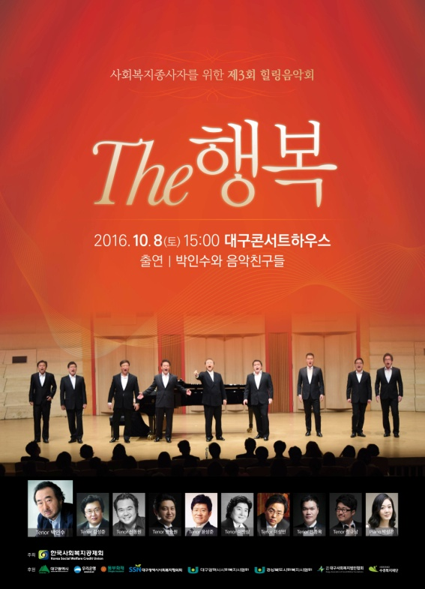
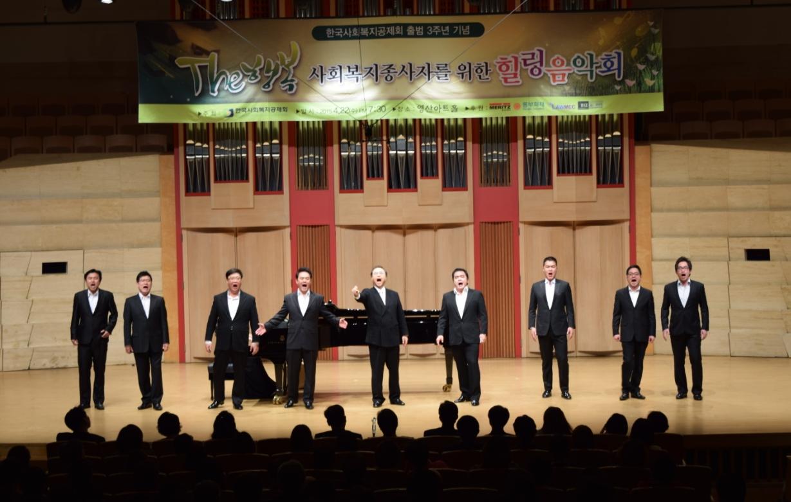
II-2. Products & Services
Korea Social Welfare Credit Union
Welfare service for members
Healing concert
Classical music concert
performed by ‘Park InSoo’, a famous tenor and his students from
Seoul National University (twice a year)

Slide 24
II-2. Products & Services
Korea Social Welfare Credit Union
Facility Care Service
Service description
Safety management & operational support for welfare facility
Contents
Free of charge safety inspection and safety training for welfare facilities (Provide the service to 120 facilities in year 2016)
Distribution of safety management guide booklet to the facilities
Education and training with regard to compulsory insurance
Insurance status research on social welfare facilities
Patronization for various events of social welfare facilities

Slide 25
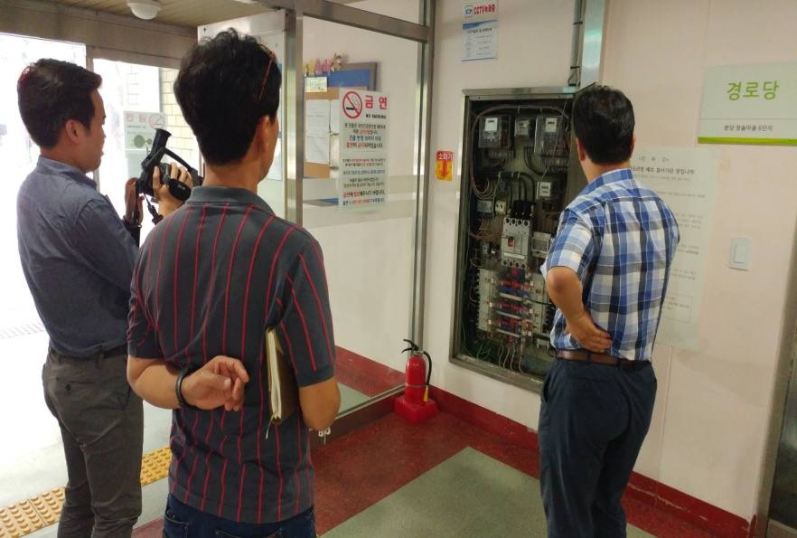
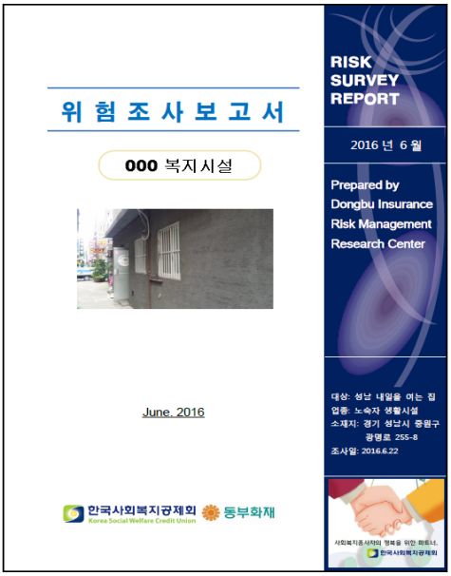
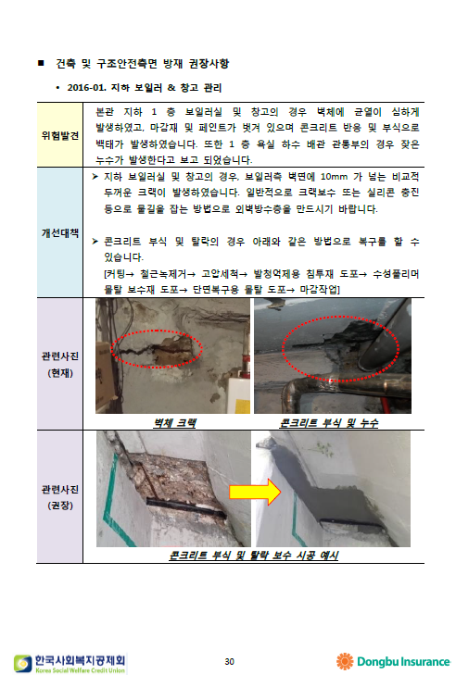
II-2. Products & Services
Korea Social Welfare Credit Union
Facility Care Service
Safety inspection service
Provide the inspection report on risk assessment for building and equipment by safety specialists.
Applicable to budgetary allocation for repairing the building and beneficial to both service users and employees in terms of safety improvement.

Slide 26
III. Key Challenges & Plan
Korea Social Welfare Credit Union
❒ Key Challenges
Securing seed money
- Need the minimum capital to build up the infrastructure and to stabilize the business of Korea Social Welfare Credit Union in early stage
- Being under discussion to get the support fund from the government and commercial entities
* Case : The government provided the support fund of KRW 200 billion (US$ 1.8 million) to Korea Scientist and Engineers Mutual-aid Association.
Exclusivity of insurance sales by Korea social welfare credit union
within the social welfare sector
- Many facilities are often inadequately insured. → the occurrence of blind area in terms of compensation or indemnity
- Costly premium and low coverage provided by commercial insurers.
- If exclusivity of insurance sales is given to Korea Social Welfare Credit Union, the effects of lower premium and higher coverage can be realized.
*Case : All welfare facilities for children should be insured by Children center Safety and Insurance Association.

Slide 27
III. Key Challenges & Plan
Korea Social Welfare Credit Union
❒ Key Challenges
3) Further programme development
- Financial programme (loan, pension, life insurance for welfare employees,
other accident protection plan for service users etc.)
- Safety management programme for welfare facilities
- Welfare benefits for members, facility support and survey study etc.
4) Building up organizational competency
- Build up asset management competency and secure more experts in each function → Maximization of business performance
- Improve business and operational management process → efficient business/expense management
- Increase transparency and social responsibility of organization → Trust and sustainability

Slide 28
III. Key Challenges & Plan
Korea Social Welfare Credit Union
Strategic goal by stage ➔ “Hope of Welfare Workers,
Power of Welfare facilities ”
Short-term(2014~2016)
Mid-term(2017~)
Long-term (2019~)
Achieve the economy of scale with insurance business
Growth through product development and sales network building
Diversify member service and revenue making business
Develop and provide the competitive products
Develop tailor-made financial products
Expand and differentiate welfare service
Strengthen welfare service benefits
Develop the business associated with welfare service
Front End
Establish and roll out the effective PR strategies
Build trustworthy brand image
Establish nation-wide service network
Develop other revenue model
Establish stable and efficient business infrastructure
Increase asset management capability
Diversify the business and set up the advanced asset management system
Secure and develop the competent resource
Stabilize the cash-flow
Strengthen the asset mgt. function
Set up asset mgt. model geared to the retained assets
Advanced asset management system
Back End
Set up the robust business process and regulations
Build cooperative network with social service organizations
Investment performance mgt.
Strengthen business planning & development competency
Investment diversification

Slide 29
IV. Conclusion
Korea Social Welfare Credit Union
1
Improvement on treatment of social welfare workforce is a key factor of social welfare development
2
Safety of social welfare facilities is a pre-requisite condition for improvement of social welfare service
3
Cooperation & combined efforts between the government (central, local) and social welfare facilities are required.
4
Social welfare cooperative can be an alternative model with low cost and high efficiency to resolve the various issues.
“The better treatment for social welfare workers
makes a happy society!”

Slide 30
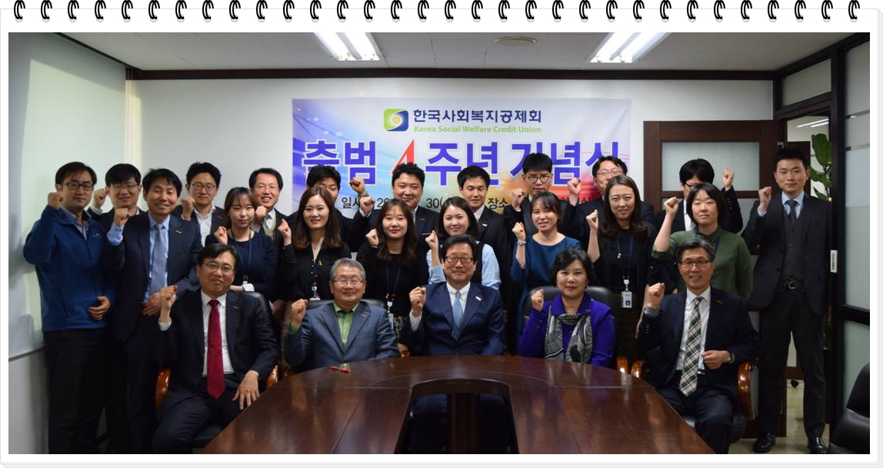
IV. Conclusion
Korea Social Welfare Credit Union
“Happy social welfare workers are able to make a happy society!”
Thank
You!

